Slide 1

Effectiveness of COVID-19 State Policies
By
Kacper Malysa
Mingxi Xia
Roman Sydorchuk
Spencer Sumner
Yurun Liu

Slide 2
Project Proposal: What are our goals?
The impact of COVID-19 has dramatically altered the daily lives of U.S. citizens.
Public policy has been haphazardly implemented.
This project seeks to examine public health policies implemented in the past seven months by American states.
A number of data repositories have publicly available information on pandemic outcomes and public responses.
Our goal is to use this data to identify the most effective public health policies for fighting COVID-19, and to establish the optimal timing of policy implementation.

Slide 3
What Questions Must Be Asked?
Which states have the most effective policies?
Which policies are the most effective?
Stay at home orders.
Non-Essential Business Closures
Large Gatherings Ban
What variables constitute a policy to be implemented?
What variables identify a policy as a success or failure?

Slide 4
Our methodology (tentative)
Linear regression analysis
Simple regression
Multiple regression
Logistic regression analysis
For which state policy is very successful or not successful
Z/T/F distribution and test
Possibly KNN
Build a training and testing model
P-value to decide the hypothesis

Slide 5
Project outline: Literature Review
The COVID-19 pandemic has provoked sweeping responses in public health policies across the globe. Given that the pandemic continues to this day, research into these policies and their effects on health outcomes is still ongoing, however, several prior publications do exist that attempt to quantify these consequences. Some of the earliest research on this subject was conducted by Hsiang et al. (2020), who focused on the effects of anti-contagion policies across the countries of China, South Korea, Italy, Iran, France, and the United States.
Within the U.S. itself the combined effects of social distancing and shelter-in-place orders were predicted to have prevented as many as 90% of COVID cases in the first two months of the pandemic (Courtemanche et al., 2020).
The identification of the most effective policies for combating COVID-19 is crucial, both for avoiding wasteful restrictions and for saving lives.

Slide 6
Data sources and reference data
Datasets
Data Lake (Must request access):
https://c3.ai/products/c3-ai-covid-19-data-lake/
KFF State Data (Data Lake uses the same data source):
https://www.kff.org/coronavirus-covid-19/issue-brief/state-data-and-policy-actions-to-address-coronavirus/

Slide 7
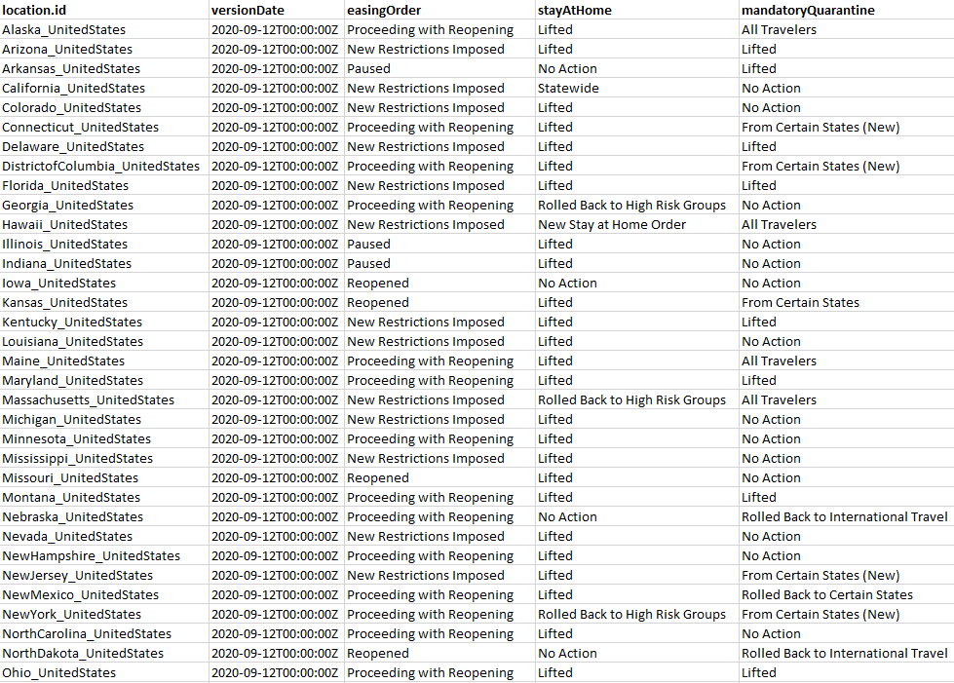
Trial data example

Slide 8
Feature Descriptions
Field | Data type | Description
location | OutbreakLocation | C3.ai Type OutbreakLocation where the policy was enacted.
easingOrder | string | "Yes" if the location is easing their social distancing measures, "No" otherwise.
stayAtHome | string | Description of the latest status of the stay-at-home order.
mandatoryQuarantine | string | Description of status of mandatory quarantine for travelers.
nonEssentialBusiness | string | Description of restrictions on non-essential businesses.
largeGatherings | string | Description of restrictions on large gatherings.
schoolClosure | string | Description of school closures or restrictions.
restaurantLimit | string | Description of restrictions on restaurants.
PrimaryElectionPostponement | string | Description of postponement or cancellation of primary elections.
emergencyDeclaration | string | "Yes" if a state of emergency was declared, "No" otherwise.
waiveTreatmentCost | string | Description of policies regarding cost sharing for COVID-19 treatment.
freeVaccine | string | Description of policies requiring free cost COVID-19 vaccines when available.
waiverOfPriorAuthorizationRequirements | string | Description of policies requiring a waiver of prior authorization requirements. May be superseded by the federal Families First Coronavirus Response Act.
prescriptionRefill | string | Description of policies regarding early prescriptions refills.
premiumPaymentGracePeriod | string | Description of policies regarding premium payment grace periods.
marketplaceSpecialEnrollmentPeriod | string | "Yes" if the special enrollment period for the state's insurance marketplace extended, "No" otherwise.
section1135Waiver | string | Description of approval status of the Section 1135 waiver.
paidSickLeaves | string | Description of status of paid sick leave policies adding to federal emergency leave.
expandsAccesstoTelehealthServices | string | "Yes" if expanded access to Tele-health services are issued, "No" otherwise.
lastSavedTimestamp | datetime | Datetime of last update for this version.

Slide 9
Feature descriptions (cont)
version | int | Incrementing version ID for all policies.
versionDate | datetime | Date of the policy version.
numSavedVersions | int | Total number of versions of this policy available with allversionsforpolicy.
savedVersion | int | Incrementing version ID for this policy.

Slide 10
Data Processing and pipeline
Data input - Pulling the data from c3.ai Data Lake using their API and documentation into R
Data cleaning - Removing null values and unnecessary or redundant data from dataset, as well as joining necessary tables when the time comes
Transformation - When pulling the data from “allVersionsForPolicy”, we have to get each state separately, so data joins will be necessary and will require more further clean up. After that, comparison between different data from the Data Lake can be made.

Slide 11
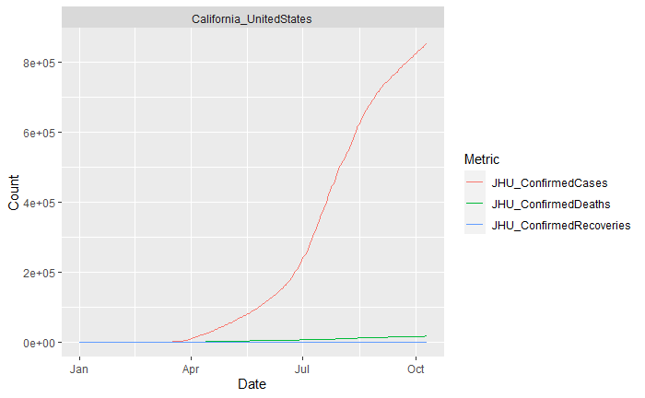
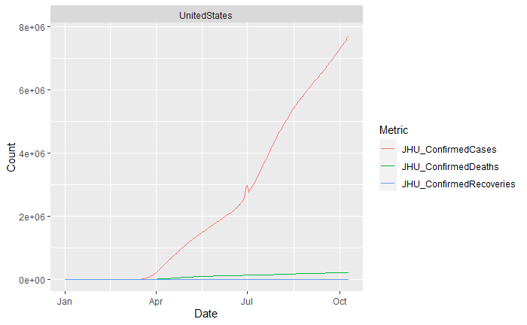
Data stylized facts
Example graphs that represent different rates over time. These types of data are the ones that we can use for comparisons against policies start and end dates.

Slide 12
Model selection
The goal of this project is to find out and predict which policies established by different states helped prevent the spread and effects of COVID-19 in the united states. As we move on with the project, we will compare the previously mentioned methods such as Linear regression, Z/T/F distribution, KNN, and so on.

Slide 13
Software packages, applications, libraries, and associated tools, etc
Software
R
Packages and Libraries
Tidyverse
Httr
Jsonlite
Fitdistrplus
Associated Tools
C3.ai COVID-19 Data Lake

Slide 14
References
Courtemanche, C., Garuccio, J., Le, A., Pinkston, J., & Yelowitz, A. (2020). Strong Social Distancing Measures In The United States Reduced The COVID-19 Growth Rate: Study evaluates the impact of social distancing measures on the growth rate of confirmed COVID-19 cases across the United States. Health Affairs, 39(7), 1237–1246. https://doi.org/10.1377/hlthaff.2020.00608
Dave, D., Friedson, A. I., Matsuzawa, K., & Sabia, J. J. (2020). When Do Shelter-in-Place Orders Fight Covid-19 Best? Policy Heterogeneity Across States and Adoption Time. Economic Inquiry, n/a(n/a). https://doi.org/10.1111/ecin.12944
Hsiang, S., Allen, D., Annan-Phan, S., Bell, K., Bolliger, I., Chong, T., Druckenmiller, H., Huang, L. Y., Hultgren, A., Krasovich, E., Lau, P., Lee, J., Rolf, E., Tseng, J., & Wu, T. (2020). The effect of large-scale anti-contagion policies on the COVID-19 pandemic. Nature, 584(7820), 262–267. https://doi.org/10.1038/s41586-020-2404-8
James, G., Witten, D., Hastie, T., & Tibshirani, R. (2013). An Introduction to Statistical Learning (Vol. 103). Springer New York. https://doi.org/10.1007/978-1-4614-7138-7
Ziedan, E., Simon, K., & Wing, C. (2020). Effects of State COVID-19 Closure Policy on NON-COVID-19 Health Care Utilization (No. w27621; p. w27621). National Bureau of Economic Research. https://doi.org/10.3386/w27621

